Slide 1
Solving two step equation
Review

Slide 2
What is a two step equation?
An equation written in the form
Ax + B = C

Slide 3


Slide 4
Opposite Operations
Addition ⇔
Subtraction
Multiplication ⇔
Division

Slide 5
Steps for Solving Two-Step Equations
Solve for any Addition or Subtraction on the variable side of equation by “undoing” the operation from both sides of the equation.
Solve any Multiplication or Division from variable side of equation by “undoing” the operation from both sides of the equation.

Slide 6

Helpful Hints?
Identify what operations are on the variable side. (Add, Sub, Mult, Div)
“Undo” the operation by using opposite operations.
Whatever you do to one side, you must do to the other side to keep equation balanced.

Slide 7
Ex. 1: Solve 4x – 5 = 11
4x – 5 = 15
+5 +5 (Add 5 to both sides)
4x = 20 (Simplify)
4 4 (Divide both sides by 4)
x = 5 (Simplify)

Slide 8

Try These Examples
2x – 5 = 17
3y + 7 = 25
5n – 2 = 38
12b + 4 = 28
x = 11
y = 6
n = 8
b = 2

Slide 9
Try These Examples
x/5 – 3 = 8
c/7 + 4 = 9
r/3 – 6 = 2
d/9 + 4 = 5
x = 55
c = 35
r = 24
d = 9

Slide 10
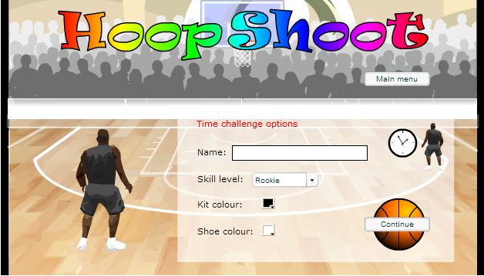
Activity one
http://www.crctlessons.com/two-step-equations-game.html

Slide 11
Activity two: design a poster
Objective:
Students will be able to construct two-step equations with one variable from real world problems and solve, with a partner and individually.

Slide 12

Activity two: design a poster
Field Trip:
For a field trip 4 students rode in cars and the rest filled nine buses. How many students were in each bus if 472 students were on the trip?

Slide 13
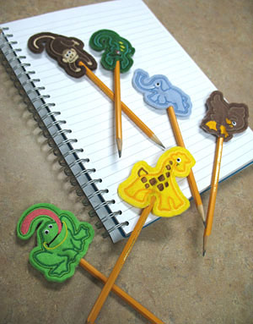
Activity two: design a poster
Cost:
Hamda had $24 to spend on seven pencils.
After buying them she had $10.
How much did each pencil cost?

Slide 14
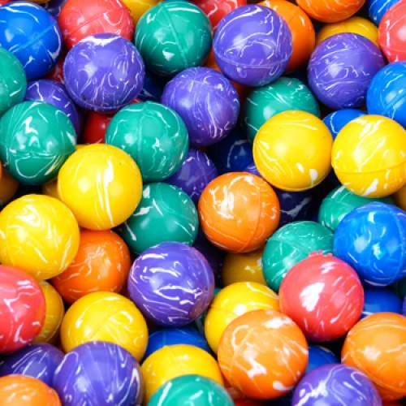
Activity two: design a poster
Super bouncy balls:
Khulod won 40 super bouncy balls playing horseshoes at her school's game night. Later, she gave two to each of her friends. She only has 8 remaining.
How many friends does she have?

Slide 15
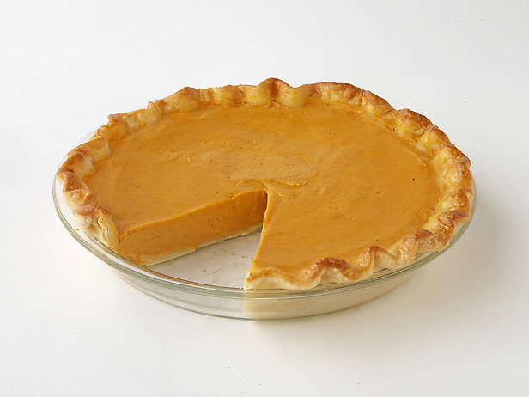
Activity two: design a poster
Cooking Club:
The Cooking Club made some pies to sell at a basketball game to raise money for the new math books. The cafeteria contributed four pies to the sale. Each pie was then cut into five pieces and sold. There were a total of 60 pieces to sell.
How many pies the club made?

Slide 16

Homework Review

