Slide 1
Solve Inequalities by Multiplication or Division
Objective: solve inequalities by using the Multiplication or Division properties of inequality

Slide 2
Review: Solve Inequality by Addition or subtracting by graphing the solution
10 < b – 8 | -21 < a - 16
n – 8 < 18 | x + 3 < 25

Slide 4
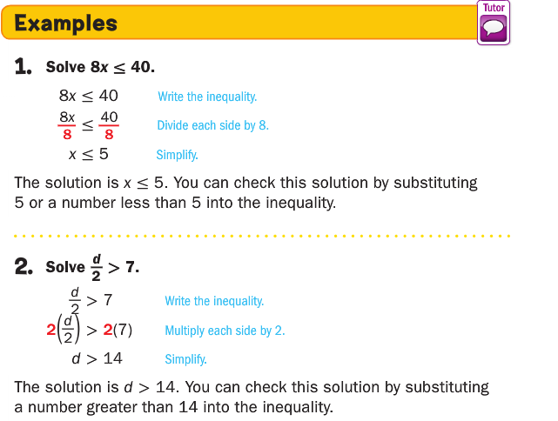

Slide 7
Solve inequalities and graph the solution
f. $\frac{t}{−4}$ < -11

Slide 8
Fun Run activity
Instruction:
Be faster than other groups to bring the inequality.
You can only bring one inequality at a time.
Solve each question as a group.
You will earn 200 if you answer as many question as you can.
You will get 100 for neatness (good handwriting)
Solve each inequality.
Good Luck!

Slide 9
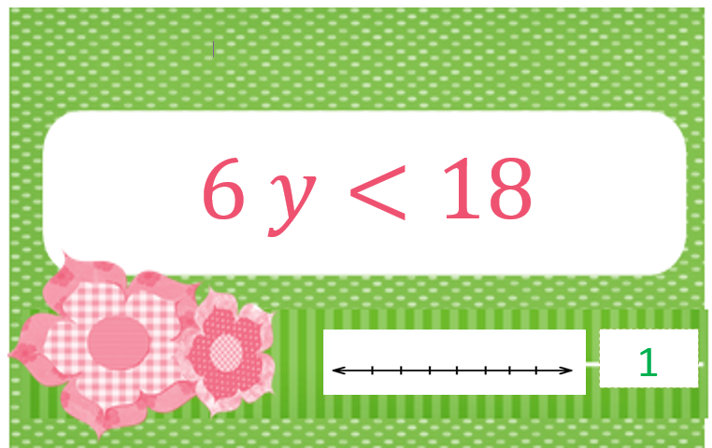
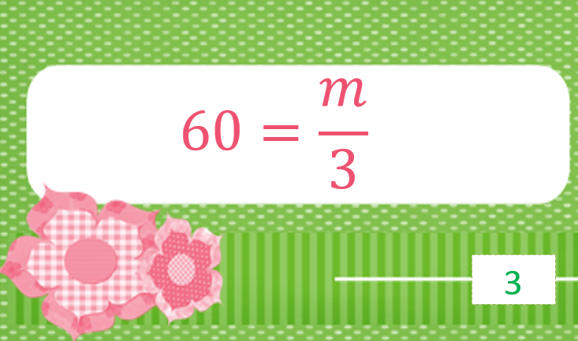
Number Line

Slide 10
Fun Run activity

Slide 11
Fun Run activity

Slide 12
Fun Run activity

Slide 13
Question of the day

Slide 14
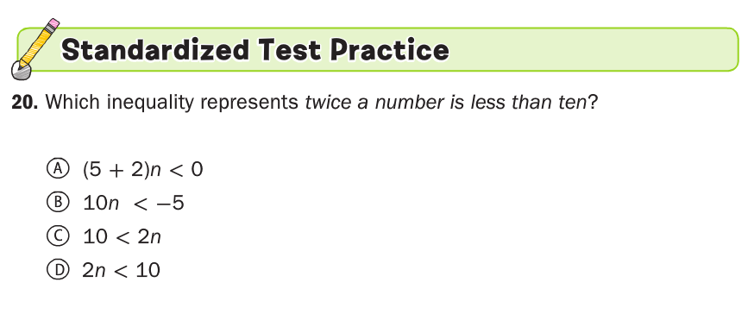

Slide 16
Review
Symbol | Words | Open or closed dot on number line?
> | Greater than | Open dot
 | Greater than or equal to
 | Less than
≤

