Slide 1
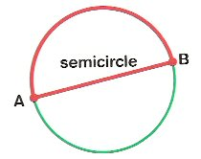
Lesson 2: Semicircle
Objective: Finding the Area of the Semicircle

Slide 2
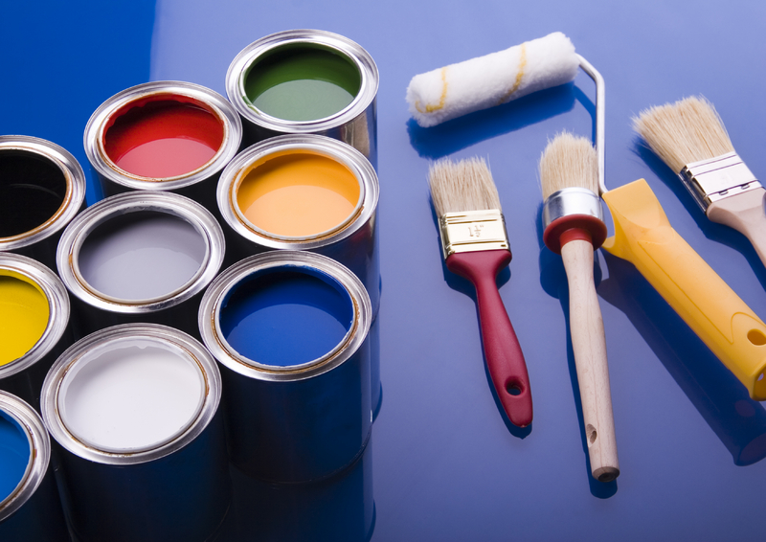
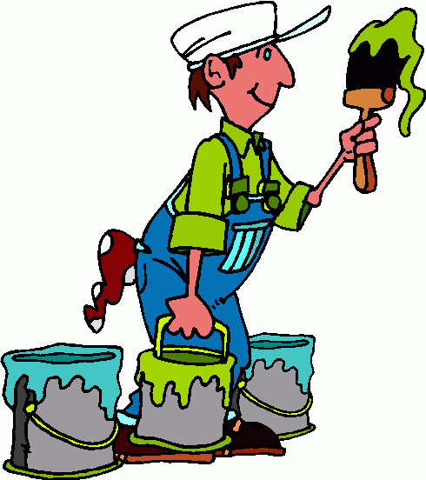
Area……A Story
He Know:
The Circumference:
Diameter:
Radius:

Slide 3
Area……A Story
But now he want to paint half of the circle!
He Know the Area of circle is:
But the area of semicircle?

Slide 4
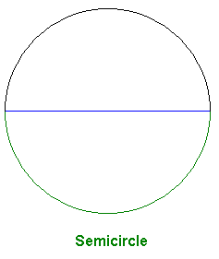

Slide 5
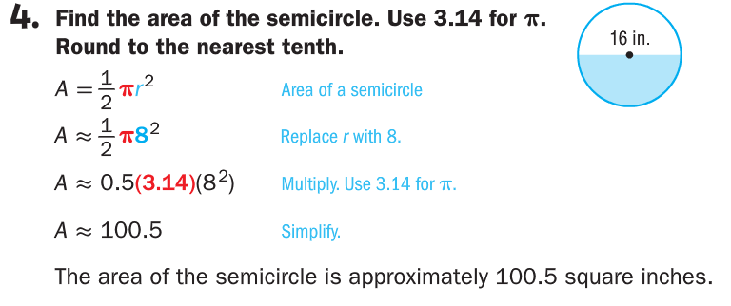

Slide 8
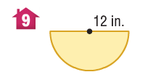
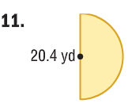
Find the Area of each semicircle. Use 3.14 for Ω

Slide 9
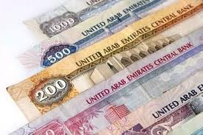
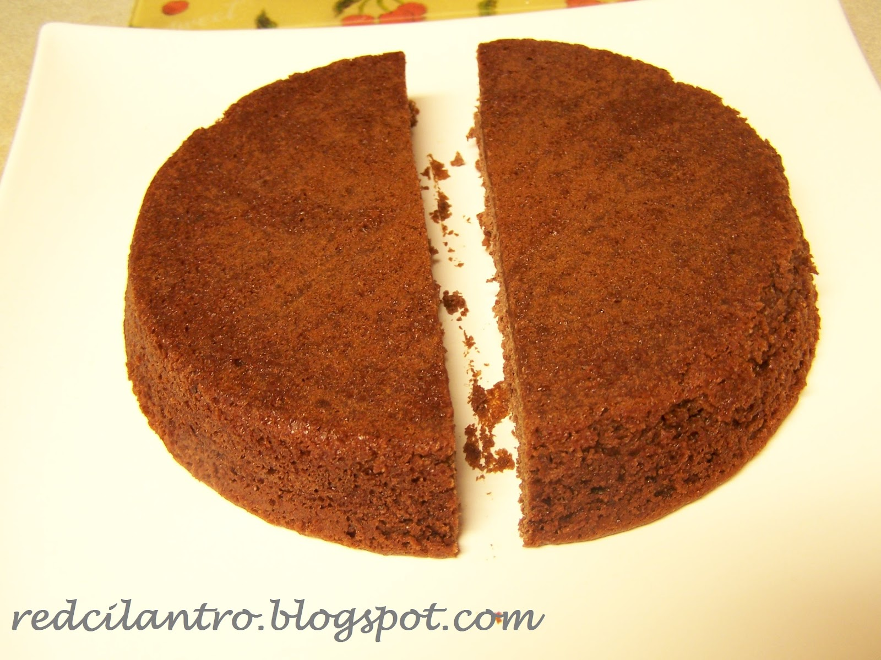
Find the Area of the semicircle cake to put cream on it

Slide 10
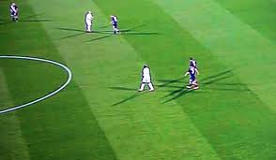
Find the area of semicircle
d= 60 cm

Slide 11
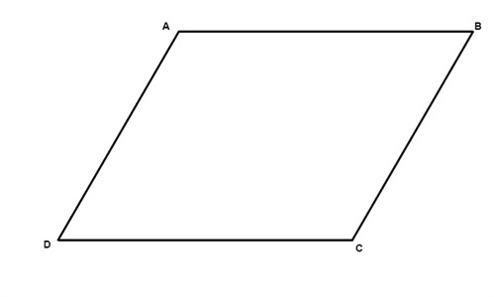
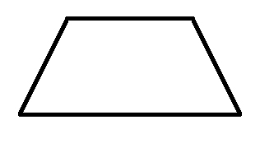
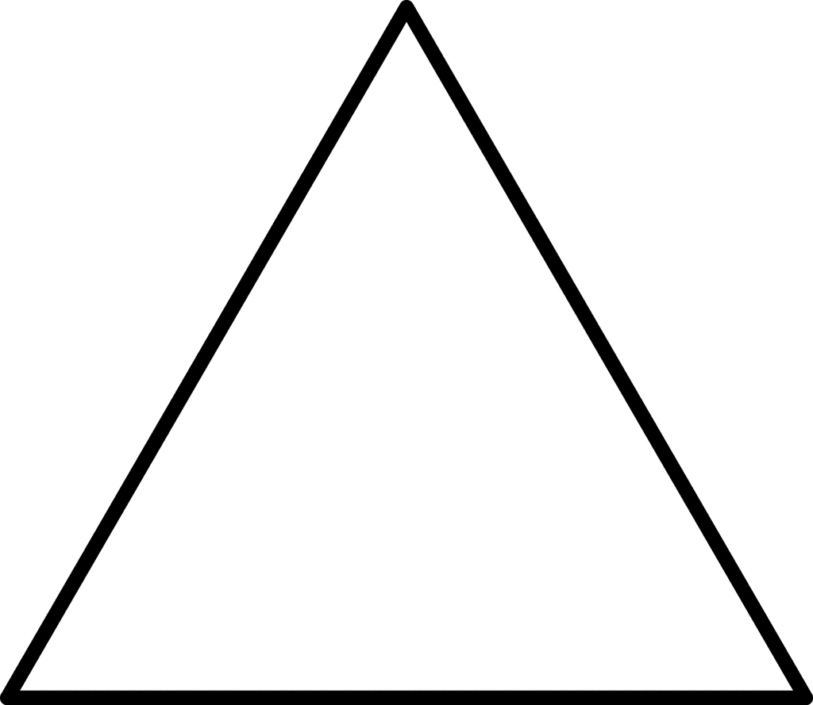
H.W: Find Area of each shape
Parallelogram | Trapezoid
Triangle | Circle

