Slide 1
Accommodate the elevator 15 person.

Slide 2
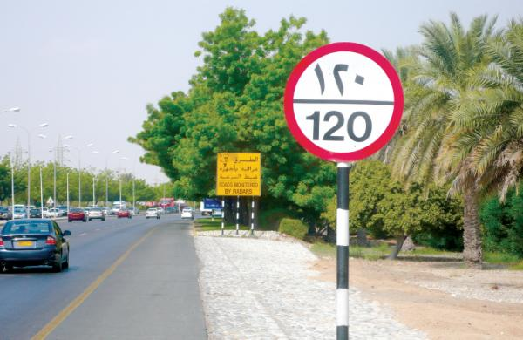
The speed which allowed in this street is 120

Slide 3
Clothing prices in this shop starting from 50 Dh.

Slide 4
Clothing prices in this shop starting from 50 Dh.

Slide 5
Lesson 6
Solve Inequality by Addition or Subtraction

Slide 6
Objective
Solve inequalities by using the addition and Subtraction Properties of inequality.

Slide 7
Vocabulary
Subtraction Property of inequality
Addition Property of inequality

Slide 20
Table No. | Question Number
1 | 1
2 | 2
3 | 3
4 | 4
5 | 5
6 | 6
Depending on the numbers written on the tables

Slide 22
